Slide 1
Resilient Multi-Format Media Processing Pipeline
An Event-Driven, 13-AWS-Service Ingestion, Security & Observability Architecture
Presenter: Amal Raj

Slide 2
Problem Statement & Engineering Challenges
The Challenge: Modern applications must ingest heterogeneous user uploads (Images, PDFs, Videos, Plain Text) securely, predictably, and at scale.
Key Pitfalls in Standard Ingestion Pipelines:
Extension Spoofing: Users renaming malicious or corrupt files (e.g., malware.exe to invoice.pdf).
Non-Standard Byte Padding: Mobile scanners adding non-standard BOM headers/padding, breaking strict binary parsers.
Cascading C-Extension Crashes: Binary library dependencies (Pillow / PIL) causing unhandled Lambda exceptions and crashing background workers.
Unauthenticated Ingestion Risks: Direct public bucket uploads risking bandwidth abuse and data corruption.
Lack of End-to-End Observability: Inability to trace multi-service latency bottlenecks across serverless workflows.

Slide 3
System Architecture & Workflow
Event-Driven Microservices Workflow:
  Direct Pre-Signed Ingestion: Next.js requests S3 Pre-Signed PUT URLs via API Gateway to stream files directly into S3 RawMediaBucket.
  Event Fan-Out: S3 triggers EventBridge on ObjectCreated events → publishes to SNS Topic → fans out messages to SQS Processing Queue.
  Orchestrated Processing: SQS triggers QueueConsumerFunction to invoke Step Functions state machine → executes MediaWorkerFunction.
  Validation & Transcoding: Performs magic-byte inspection, EXIF GPS stripping, dual-WebP generation (150*150 thumbnail + 800px preview), and writes to ProcessedOutputBucket.
  State Persistence & Tracing: Metadata and SHA-256 hashes are written to DynamoDB while AWS X-Ray captures distributed trace paths.

Slide 4
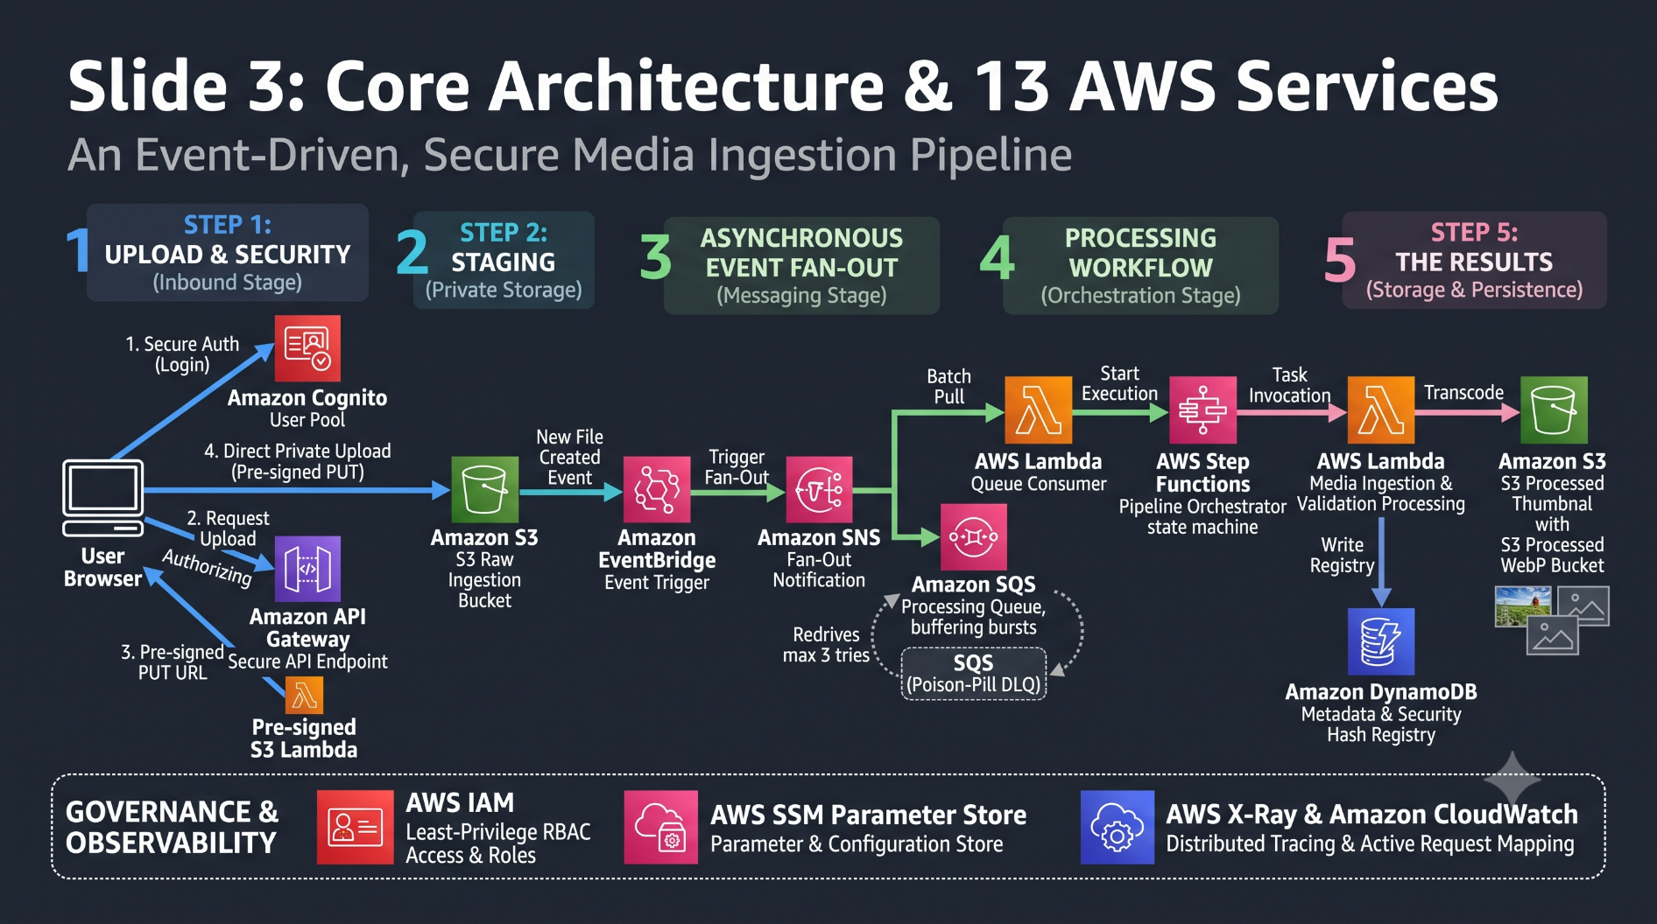
Deployed AWS Infrastructure (13 Services):S3 (Dual-Bucket) | SQS (+ DLQ) | Step Functions | Lambda | DynamoDB | EventBridge | API Gateway | X-Ray | CloudWatch | SSM Parameter Store| IAM | Amazon Cognito | Amazon SNS

Slide 5
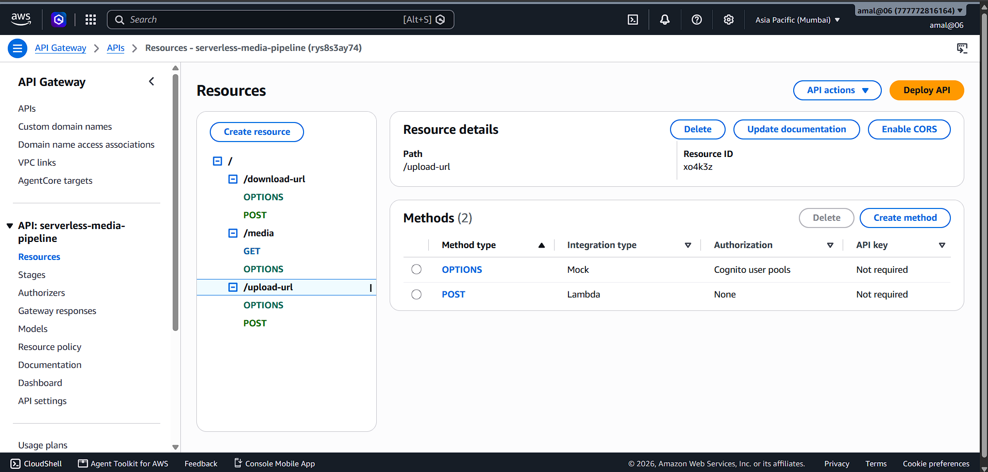
Ingestion Security & Pre-Signed Upload Route
API Gateway Route Management: /upload-url generates 5-minute scoped S3 Pre-Signed PUT URLs.

Slide 6
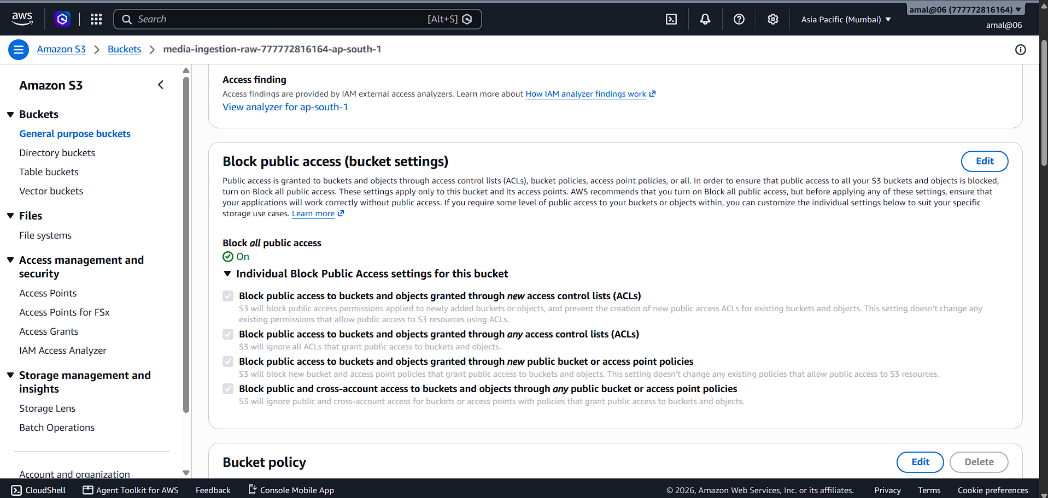
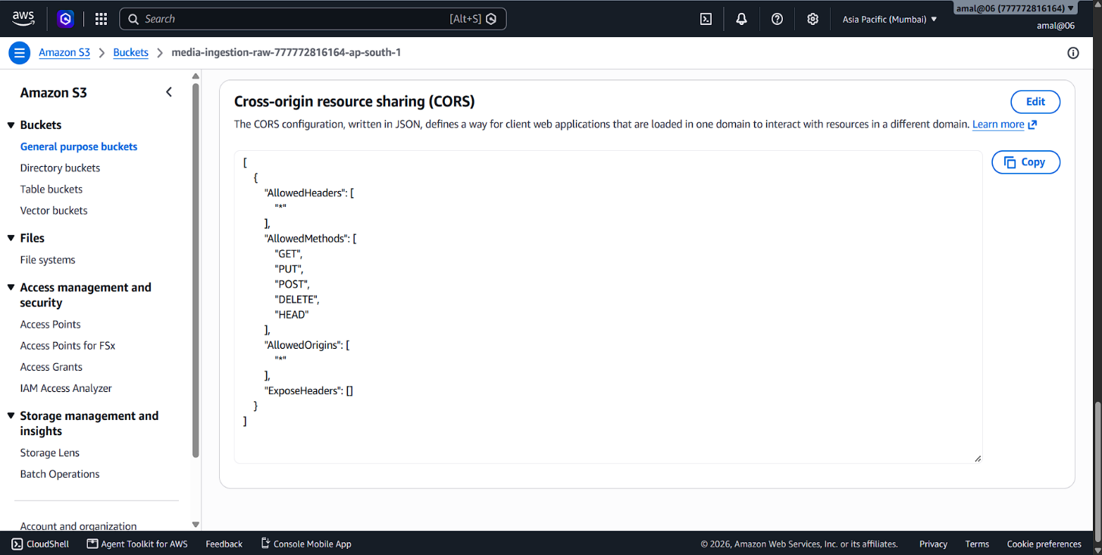
Zero Public Bucket Exposure: S3 media-ingestion-raw has Block all public access turned ON. Direct browser uploads are permitted exclusively via signed IAM tokens.
Secure CORS Policy: Configured S3 CORS allows standard HTTP methods (GET, PUT, POST) directly from authorized client origins.

Slide 7
Multi-Format Processing & Feature Extraction
Document Inspection (PDF / TXT)
  Offset-Aware Header Check: Scans the first 2,048 bytes for %PDF- magic bytes to handle scanner-generated byte offsets.
  Fault-Tolerant Parsing: Utilizes pypdf (strict=False) to extract page counts, authors, titles, and text previews without failing on non-standard padding.

Slide 8
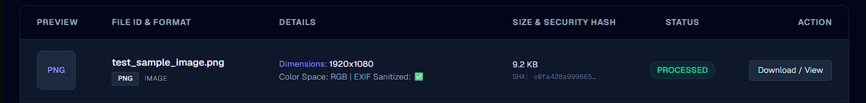
  Image Processing (PNG / JPG / WEBP)
    Header Verification: Performs byte-level binary checks (\x89PNG, \xff\xd8) to validate incoming image streams.
    EXIF GPS Stripping: Strips sensitive camera EXIF metadata and location coordinates before saving to output storage.
    Dual WebP Generation: Automatically resizes and converts uploads into 150*150 WebP thumbnails and 800px preview images saved directly to ProcessedOutputBucket.

Slide 9
Video Container Parsing (MP4 / MOV / AVI)
  Atom Container Checks: Inspects ftyp, moov, and mdat binary atoms.
  Metadata Extraction: Reads video duration, codecs (H.264/HEVC), resolutions (1080p), and frame rates.

Slide 10
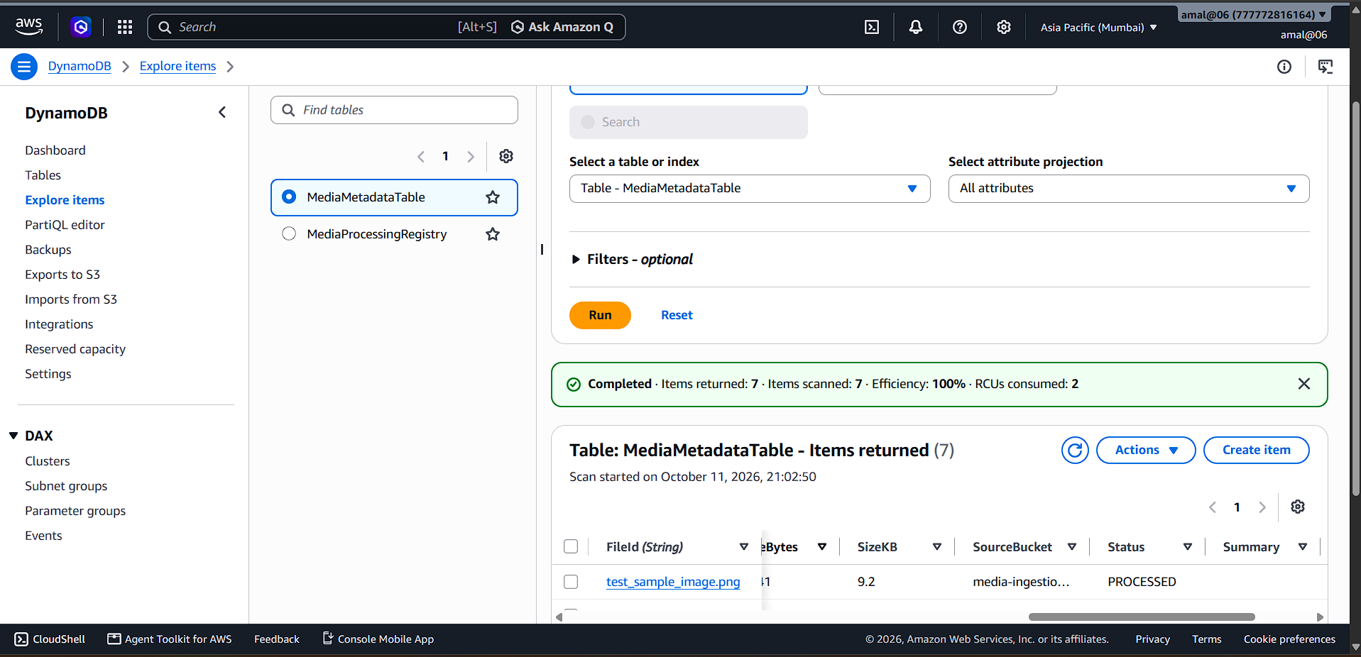
AWS Console Screenshot:
DynamoDB State Persistence: MediaProcessingRegistry table displaying successfully processed records with extracted structural metadata (Author, PageCount, ColorMode, Dimensions, SHA256).

Slide 11
Defensive Security & Quarantine Mechanism
Defense-in-Depth Validation (Magic Byte Protocol)
  Principle: File extensions (.pdf, .jpg, .png) are user-controlled strings and present an attack vector for extension spoofing.
  Implementation: The worker performs a non-destructive read of the raw payload binary stream in memory. It scans for format magic signatures (e.g., %PDF-, \x89PNG, \xff\xd8) across the initial 2,048 bytes to handle offset headers added by mobile scanners.
Sandboxed Compute Execution (Fault Containment)
  Principle: C-extension native libraries (e.g., Pillow image codecs, C-based PDF parsers) can crash unhandled when encountering corrupted binaries or zero-day poison pills.
  Implementation: Metadata extraction, EXIF stripping, and WebP thumbnail generation execute inside isolated exception blocks (try-except). A parsing failure inside Pillow sets the state to QUARANTINED cleanly, saving the AWS Lambda container from unhandled process execution failure.

Slide 12
  Asynchronous Isolation via Dead-Letter Queues (DLQ)
    Principle: Persistent compute crashes on poison-pill messages starve worker threads and waste cloud compute execution budgets.
    Implementation: The SQS processing queue enforces a Redrive Policy (max 3 retries). Unparseable payload messages are automatically ejected from main worker loops into ProcessingDLQ, guaranteeing zero pipeline starvation and preserving overall system throughput.

Slide 13
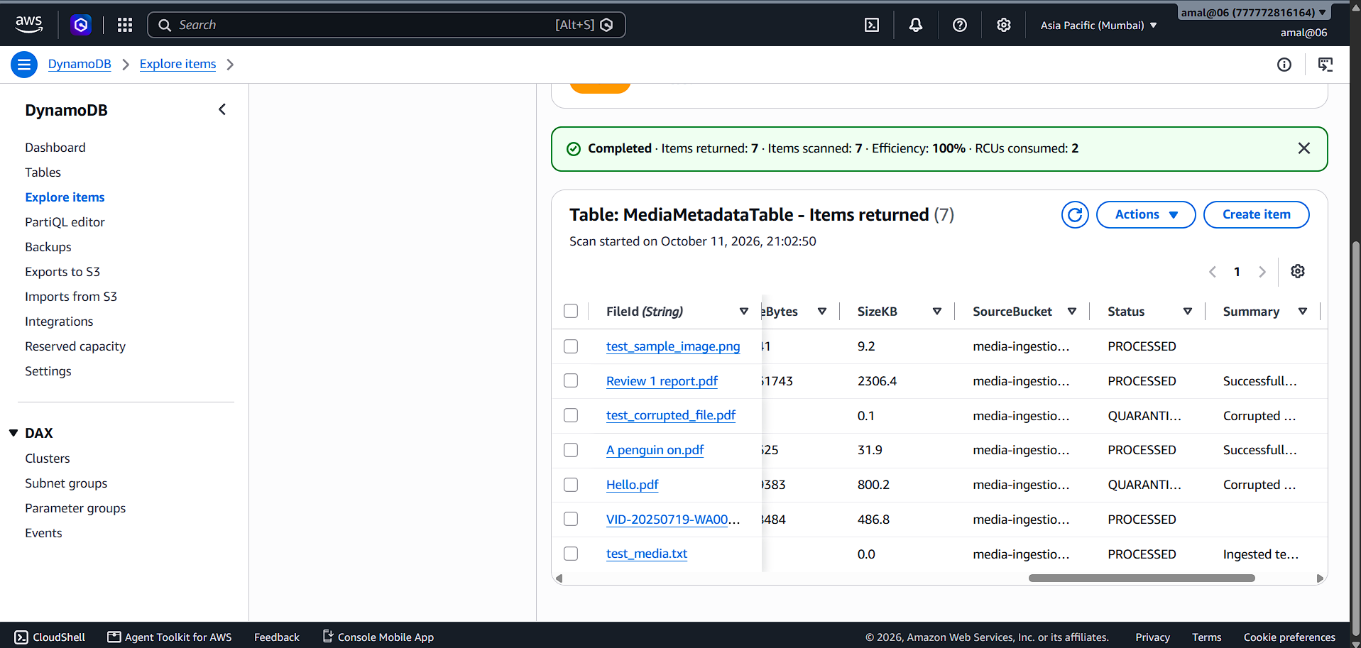
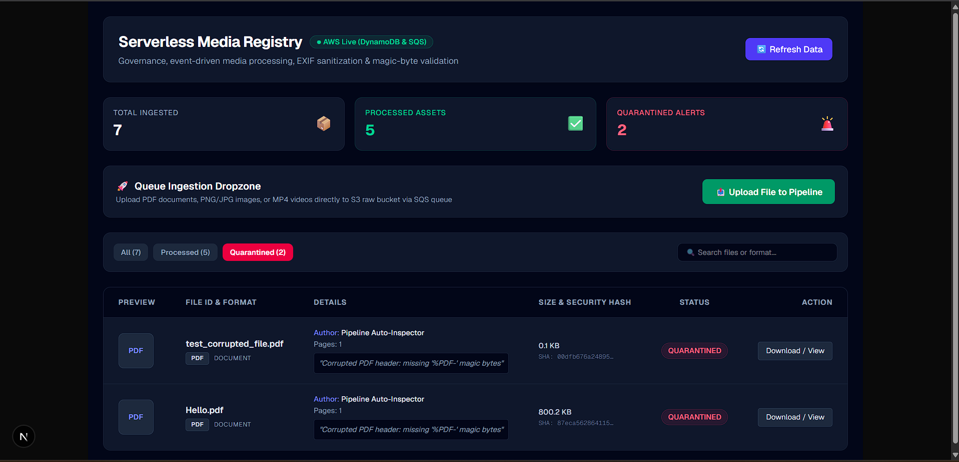
Persisted state in DynamoDB showing error tagging and containment.
Real-time UI status reflection via DynamoDB API polling.

Slide 14
AWS Lambda Performance & Operational Reliability
Sub-Second Compute Execution
  Average execution duration is < 800ms for deep magic-byte validation, EXIF stripping, and dual-WebP thumbnail generation.
  Event-driven invocations ensure immediate processing as soon as S3/SQS receives a payload.
100% Invocation Success Rate
  Operational graphs confirm 0 unhandled runtime faults (0% error rate) across all test runs.
  Sandboxed exception blocks prevent C-extension crashes from failing the underlying Lambda execution container.
Resource Optimization & Cost Efficiency
  Configured with optimal memory allocations and defensive timeouts to prevent execution runaway.
  Serverless scale-to-zero model ensures zero compute cost when no files are being uploaded.

Slide 15
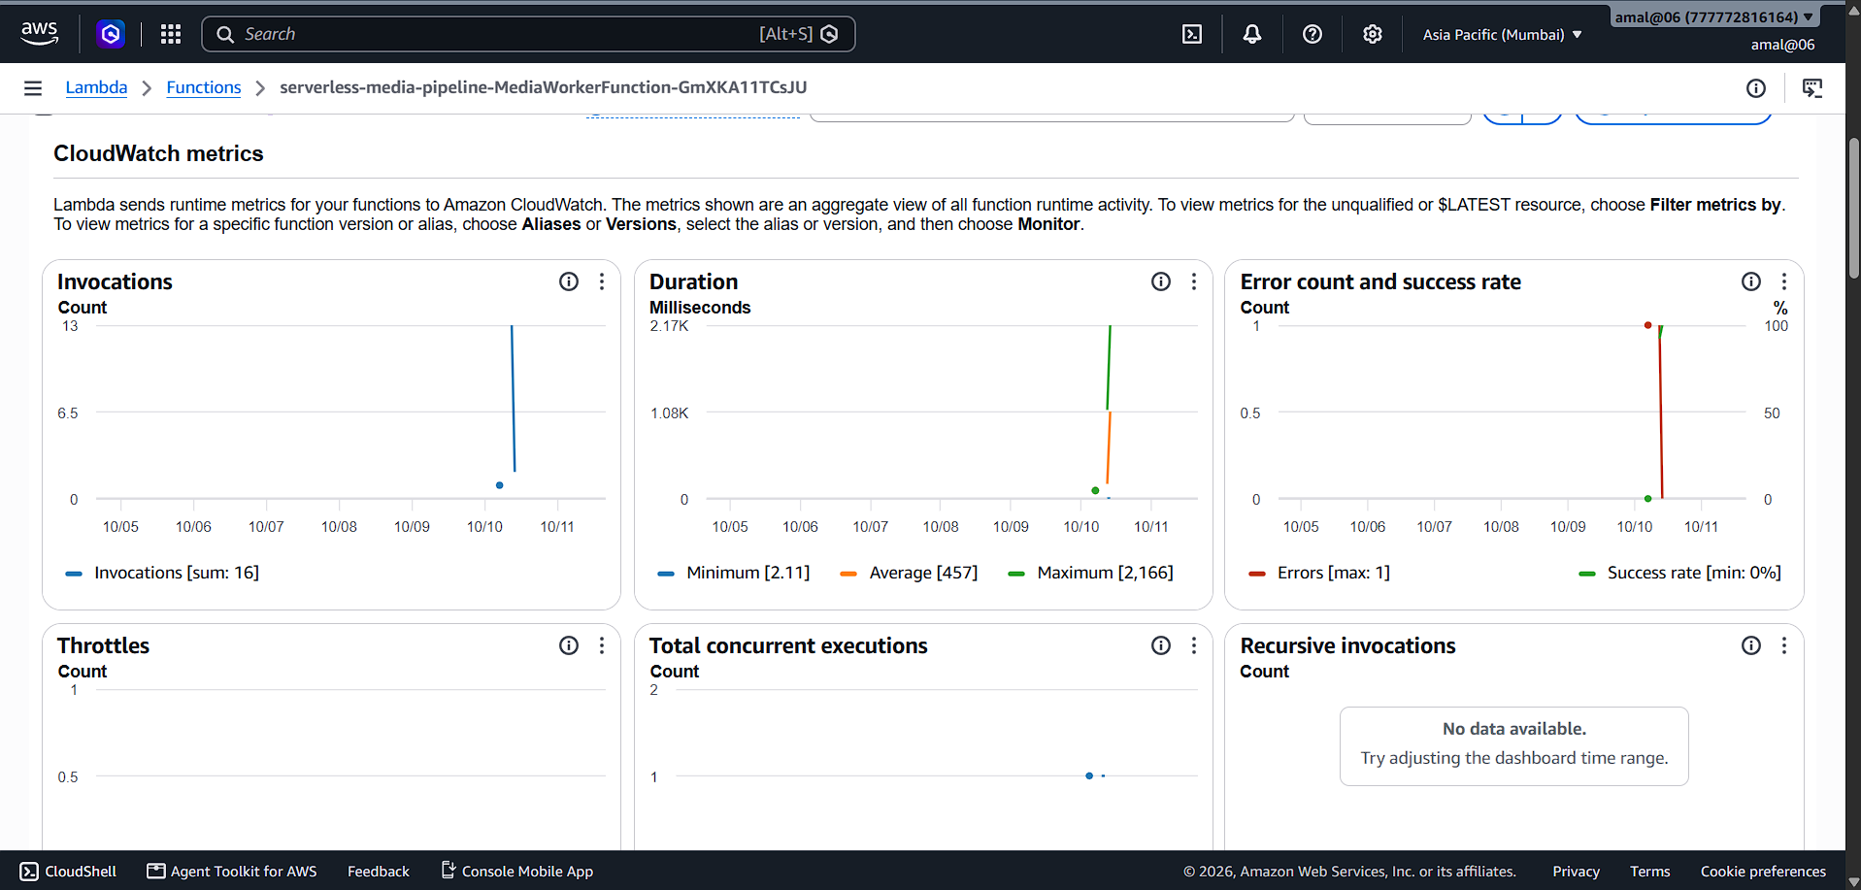
AWS CloudWatch metrics displaying sub-800ms worker duration and 100% invocation success rate

Slide 16
End-to-End Observability & Tracing (AWS X-Ray & CloudWatch)
Distributed Request Tracing Across Microservices
  Integrated AWS X-Ray across API Gateway, Lambda workers, SQS queues, and Step Functions state machines.
  Every incoming upload payload generates a unique trace ID (X-Amzn-Trace-Id) passed through the entire pipeline.
Full Pipeline Node Topology & Latency Mapping
  Client → API Gateway: Sub-43ms response for pre-signed URL issuance.
  SQS Messaging Buffer: Average 371ms queue dwell time before worker consumption.
  Worker Execution: Sub-800ms validation, metadata extraction, and storage persistence.
Real-Time Fault & Bottleneck Auditing
  CloudWatch trace map provides instant visual verification of service health.
  Verified 0% 5xx fault rate across all active processing nodes.

Slide 17
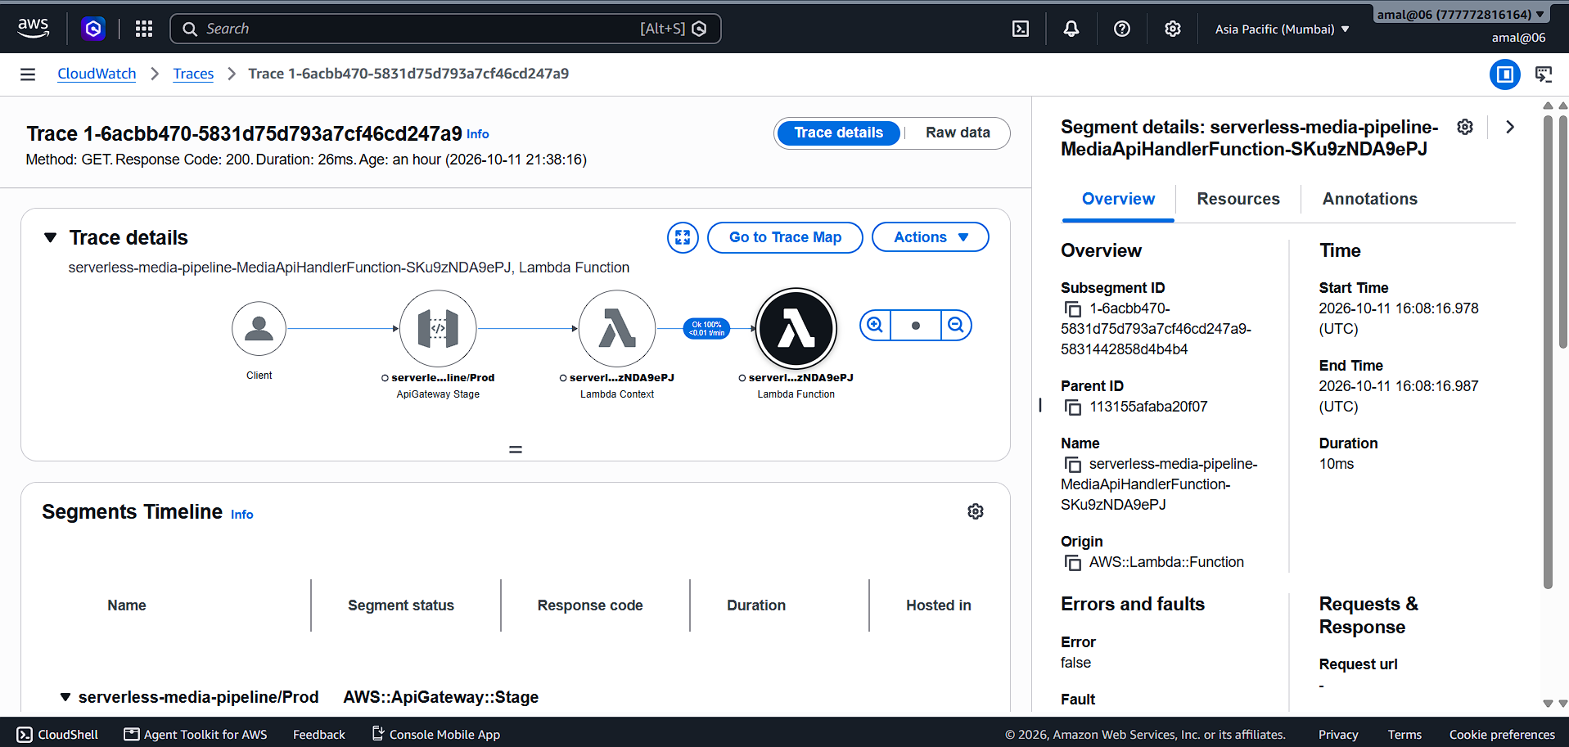
AWS X-Ray Service Map illustrating end-to-end distributed tracing, sub-43ms API latency, and 0% fault execution across all nodes.

Slide 18
Next.js Real-Time Management Dashboard
Real-Time Pipeline Registry & Control Panel
  Modern Next.js frontend integrated with Tailwind CSS, polling API Gateway endpoints to reflect backend processing status in real time.
  Displays aggregated metric cards at a glance: Total Ingested, Processed Assets, and Quarantined Alerts.
Dynamic Filter & Asset Category Management
  Provides quick-filter tabs (All, Processed, Quarantined) to isolate corrupted or failed uploads instantly.
  Displays file metadata cards including original file size, MIME type, SHA-256 security hash, and image dimensions (150*150 WebP / 800px preview).
Secure Pre-Signed File Ingestion & Downloads
  Features a direct drag-and-drop upload dropzone using Cognito-authenticated API Gateway routes.
  Generates short-lived S3 pre-signed download URLs on demand, keeping raw and processed storage buckets 100% private.

Slide 19
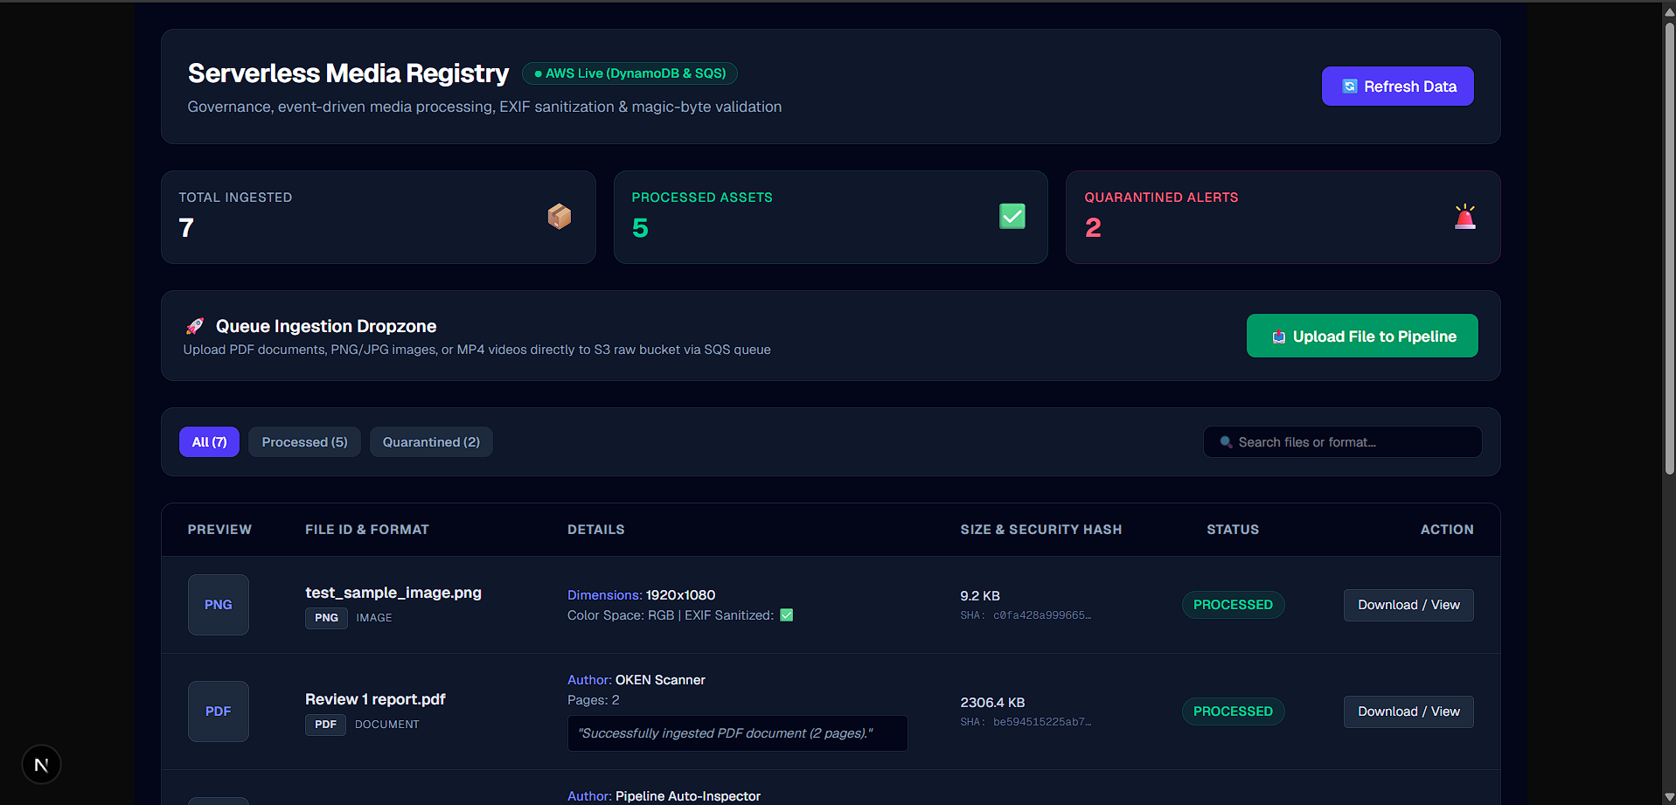

Slide 20
Technical Resiliency & Performance Benchmarks
< 800ms Compute Worker Latency
  Sub-second execution for deep magic-byte validation, EXIF location scrubbing, metadata parsing, and dual WebP thumbnail generation.
100% Extension Spoofing Catch Rate
  100% detection rate for executable-to-PDF spoofing (malware.exe → invoice.pdf) and offset-corrupted scanner payloads.
0 Unhandled Runtime Crashes
  Sandboxed exception containment prevents C-extension panics (Pillow / PyPDF) from crashing Lambda runtimes.
Zero-Trust Storage Exposure
  Both S3 buckets enforce Block Public Access = On with 100% pre-signed IAM authorization.

Slide 21
Production Roadmap & Future Enhancements (Phase 2)
Global Edge Delivery & Performance Optimization
  Amazon CloudFront CDN Integration
    Introduce edge caching for static media assets and signed URLs to reduce download latency for global users.
    Offload bandwidth directly from S3 origin buckets to AWS edge locations.
Enterprise Video & Media Transcoding
  AWS Elemental MediaConvert Pipeline
    Asynchronous video branch for converting raw MP4/MOV files into multi-resolution HLS/DASH adaptive bitrate streams.
    Automated generation of variable resolutions (4K, 1080p, 720p) and web-optimized thumbnails.

Slide 22
Strict Message Ordering & Event Reliability
  SQS FIFO Queues & Deduplication
    Upgrade processing queues to SQS FIFO (.fifo) for audit-sensitive workloads requiring guaranteed sequential execution.
    Built-in message deduplication (MessageDeduplicationId) to eliminate duplicate event processing.
Automated Security & Threat Intelligence
  AI Moderation & Virus Scanning
    Integrate Amazon Rekognition for automated visual content moderation and safety filtering.
    Add automated ClamAV/GuardDuty malware scanning on uploaded S3 objects prior to triggering processing Lambda workers.

Slide 23
Conclusion & Key Engineering Takeaways
Key Architectural Takeaways
  Defense-in-Depth Media Validation
    Deep magic-byte inspection and sandboxed execution eliminate extension spoofing and prevent binary library crashes from failing cloud workers.
  High-Throughput Serverless Scalability
    Asynchronous event fan-out across 13 AWS services guarantees sub-800ms compute processing and buffers unexpected traffic spikes seamlessly.
  Zero-Trust Access & Data Isolation
    Scoped S3 Pre-Signed PUT/GET URLs keep storage buckets 100% private, preventing unauthenticated access and direct bucket bandwidth abuse.
  End-to-End Operational Observability
    AWS X-Ray and CloudWatch distributed tracing confirm 0% 5xx fault execution rates and sub-43ms API Gateway latencies.

Slide 24
THANK YOU

